Slide 1
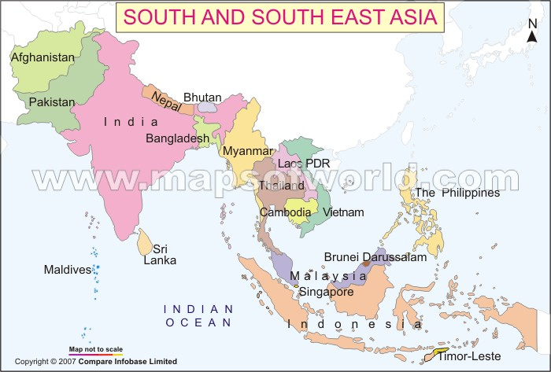
SOUTH AND SOUTHEAST ASIA COUNTRIES

Slide 2
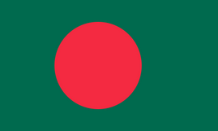
BANGLADESH

Slide 3
The flag symbolizes the green field as well as the rising sun. The blood-red color of the national flag bears the testimony of our bloodshed of achieving independence. It also represents the rising sun over the green fields and the evergreen subtropical forests of our country

Slide 4
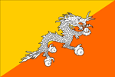
BHUTAN

Slide 5
The dragon on the Bhutan flag is white to symbolize purity. The dragon is holding jewels in its claws and these represent wealth. The snarling mouth of the dragon represents the strength of the people protecting the country. The colors of the Bhutan flag represent spiritual and temporal power within the country. The orange represents the Drukpas monasteries and Buddhist religion, and the orange/ yellow symbolizes the secular authority of the dynasty.

Slide 6
BRUNEI

Slide 7
The coat of arms on the Brunei flag is a crescent (symbol of Islam) joined with a parasol (symbol of monarchy), with two gloves on both sides. Below the crescent is a ribbon. The crescent and ribbon have Arabic inscriptions which translate to "State of Brunei, Abode of peace" and "There is no deity but God, Muhammad is the messenger of God".

Slide 8
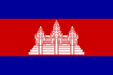
CAMBODIA

Slide 9
The blue color symbolizes the country's royalty. The red represents the nation and the white represents the religion, beginning with Brahmanism, and the current major religion - Buddhism. The emblem of the temple represents the structure of the universe.

Slide 10
EAST TIMOR

Slide 11
The centre of the black triangle there is a white star of five ends, meaning the light that guides. The white star has one of its ends turned towards the upper right end of the flag. The remaining part of the flag is red. The colours mean: Yellow: the traces of colonialism; Black: the obscurantism that needs to be overcome; Red: the struggle for national liberation; White: peace.

Slide 12
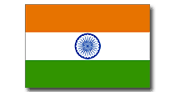
INDIA

Slide 13
Saffron - a symbol of courage White - peace and honesty Blue - vigilance, truth and loyalty, perseverance & justice Green - hope, joy , fertility and love and in many cultures have a sacred significance

Slide 14
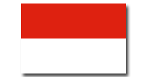
INDONESIA

Slide 15
White - peace and honesty Red - hardiness, bravery, strength & valor

Slide 16
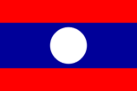
LAOS

Slide 17
The Red stripes represent the blood shed in the country's fight for independence. The blue stands for Laos' wealth and prosperity and the white symbolizes unity and justice. Another interpretation of the Laotian flag states the white circle symbolizes the full moon over the blue Mekong River, which runs through and alongside the majority of Laos.

Slide 18
MALAYSIA

Slide 19
The 14 stripes and points of the star represent the 13 member states of the Malaysian federation and the Federal District of Kuala Lumpur. They represent equal status in the federation of the states and in the federal government. The crescent and star imagery represent Islam, and yellow is a traditional royal color. The blue square stands for unity of the Malaysian people. The blue was originally adopted from the British Union Jack and represented Malaysia's link to Britain.

Slide 20
MALDIVES

Slide 21
The red base represents the blood spilled for independence and the nation's sovereignty. The green stands for peace and prosperity as well as the country's wealth of palm trees and the crescent symbolizes the Islamic faith of the island nation.

Slide 22
MYANMAR

Slide 23
The Blue represents peace and endurance. The red symbolizes courage and gallantry, and the white stands for purity and honor. Together, the cogwheel and ears of rice represent the country's industry and agriculture, as well as the union of the workers and the peasant class. The 14 stars above the 14 cogs represent the 14 states that form the Union of Myanmar.

Slide 24
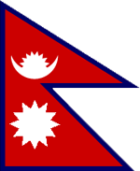
N E P A L

Slide 25
The crimson/red color is a traditional Nepalese color and the blue outlined edge represents the country's peaceful nature. The two triangular portions of the Nepalese flag represent the Himalayan Mountains and the two main religions of the nation - which are Buddhism and Hinduism. The moon and sun originally represented the royal family and the prime minister's family, the Rana family. They also represent the country's desire to live as long as the sun and moon.

Slide 26
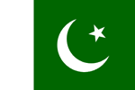
PAKISTAN

Slide 27
Green is a traditional Islamic color and the crescent and star are also Islamic symbols. The white stripe represents the non-Muslim, minority, religious groups in Pakistan. According to modern meaning, the green represents prosperity; white symbolizes peace; the white crescent represents progress; and the white star represents light and knowledge.

Slide 28
PHILIPPINES

Slide 29
The blue stripe symbolizes patriotism and justice. The red represents valor and the blood spilt for freedom and independence and the white stands for peace and purity. The white triangle represents equality and the Katipunan nationalist organization. The three stars represent the three main geographical regions of the Philippines: Luzon, Mindanao and Visayas. The sun represents independence and its eight rays represent the eight provinces that led the Philippine uprising against Spanish rule.

Slide 30
SINGAPORE

Slide 31
The red represents universal brotherhood and equality of man and the white stands for purity and virtue. The crescent moon, symbolizes the young nation of Singapore on the rise and the five stars represent the country's ideals of democracy, peace, progress, justice and equality.

Slide 32
SRI LANKA

Slide 33
The green stripe represents Sri Lanka's minority Muslims and the orange stripe the minority Hindu Tamils. The yellow represents Buddhism and the crimson stands for a long life. The golden lion is an ancient symbol of the people and the sword is a symbol of authority. The pipul tree leaves are a Buddhist symbol and come from the tree, under which Gautama is said to have received enlightenment and become Buddha. Individually the leaves represent love, compassion, sympathy and equanimity.

Slide 34
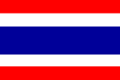
THAILAND

Slide 35
The red stripes represent the blood spilt to maintain Thailand's independence. The white stands for purity and is the color of Buddhism which is the country's main religion. Blue is Thailand's national color and it represents the Thai monarchy. The blue is also used to honor Thailand's World War I allies, Great Britain, France, United States and Russia, who all had red, white and blue flags.

Slide 36
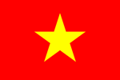
VIETNAM

Slide 37
The red base represents blood spilt during the country's fight for independence. The star represents Vietnam's unity and the points on the star represent the union of the workers, peasants, soldiers, intellectuals and young people working together in building socialism.

